Slide 1
Travel Request Bot
Process of automatically Generating Travel Ticket
Presented By :
Gaurav Bagal
&
Prathmesh Shimpi
(RPA Batch – )

Slide 2
Content
Introduction
Aims & Objectives
Methodology
Project Flow
Data Flow Diagram
Use case Diagram
Result
Advantages
Limitations
Conclusion

Slide 3
Introduction
The Travel Request Bot automates the handling of employee travel requests via email.
It reads emails with subjects TravelRequest_Domestic or TravelRequest_International and forwards them to the Group Head for approval.
Based on the approval or rejection, the bot generates tickets or logs the request in respective files.
The bot ensures faster processing, accuracy, and better tracking of travel requests.

Slide 4
Aims & Objectives
To automate the entire travel request and approval process.
To reduce manual effort, errors, and delays in managing travel requests.
Read and process travel request emails automatically.
Generate tickets for approved travel requests and log rejected or cancelled ones.
Maintain separate files for approved, rejected, and cancelled requests.
Generate monthly reports summarizing travel counts, approval status, and traveler/location-wise details.

Slide 5
Methodology
Bot 1 Main
Read Email Domes\Internat
Bot 2 Approval
Bot 3 Cancel
Cancelled
Approve\Reject
Generate Ticket
Request

Slide 6
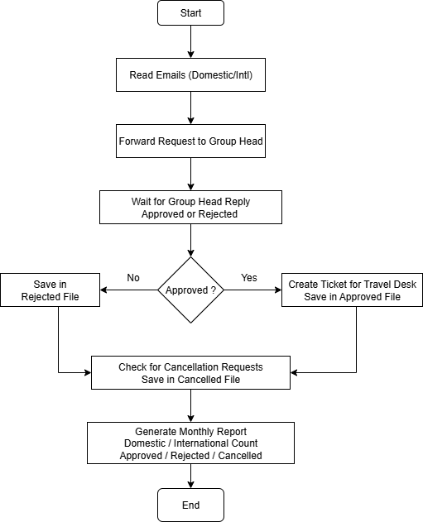
Project Flow

Slide 7
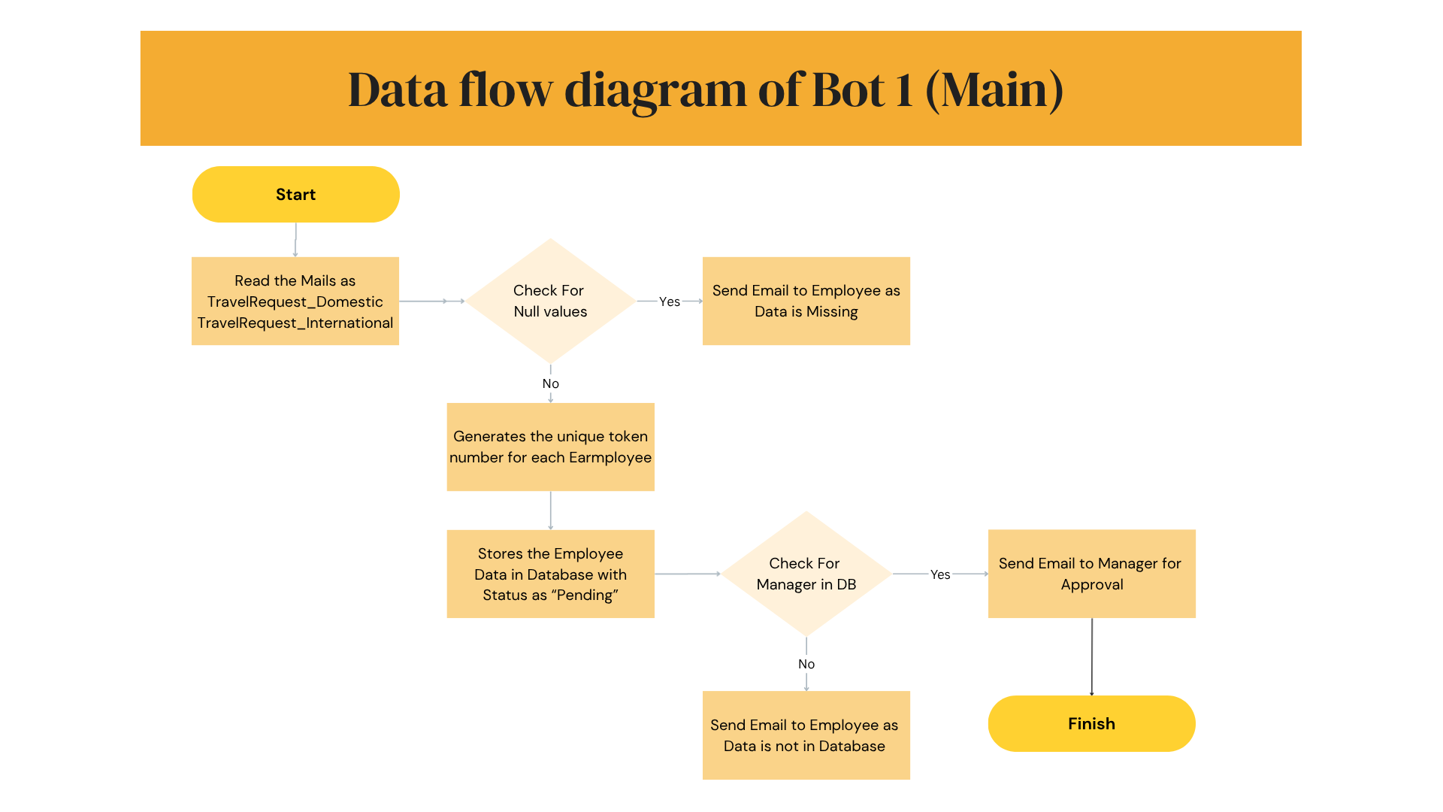

Slide 8
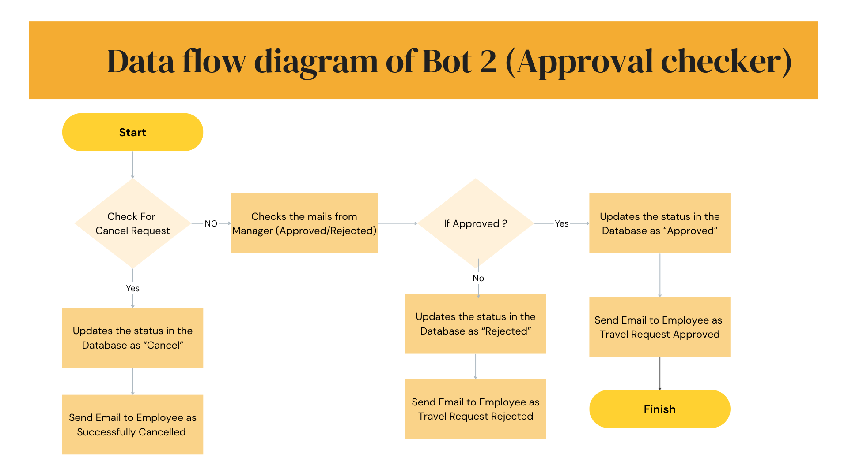

Slide 9
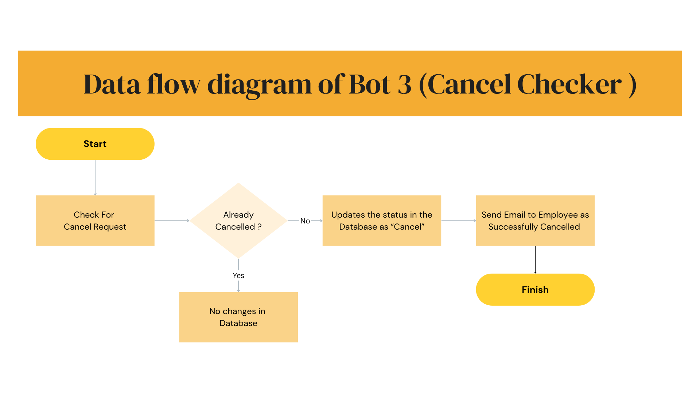

Slide 10
Exceptions Handled in the Project
Handles cases where data is null or missing.
HanHandles duplicate data entries.
Handles cases where the travel request is canceled before approval.
Handles situations where the employee data is not found in the database.
Handles changes in the email subject line.
Handles cases with the same employee name but different email IDs.
Handles scenarios with the same employee name but different travel dates.

Slide 11
Use case Diagram
Read Email and download Attachments
Send request to the respective Manager
System
Generate the Ticket for Approved user
Handles Cancel requests & store in Database
Generates Monthly report based

Slide 12
Use case Diagram
Send Input file Domestic\International
User
Replay with Approved or Rejected
Replay with “Cancel” for cancelling the booking

Slide 13
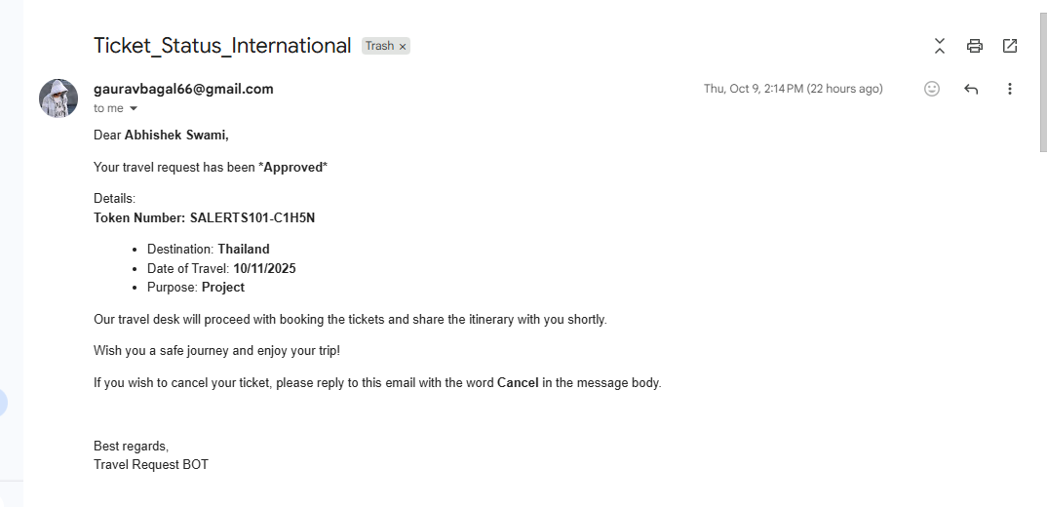
Results

Slide 14
Advantages
Provides real-time status updates
Speeds up approval process
Saves time through automation
Ensures transparency and consistency.
Reduces administrative workload.
Reduces manual errors

Slide 15
Limitations
Case sensitive subject name
Requires stable internet connection.
Dependent on email and server availability.
Limited handling of unstructured email formats.
Needs regular maintenance and updates.
Cannot process manual approvals outside workflow

Slide 16
Conclusion
Overall, it simplifies travel management and supports a smooth, paperless workflow.
Automated reporting and tracking enhance transparency and efficiency.
It reduces manual effort, improves accuracy, and ensures faster approvals.
The Travel Request Bot automates the entire travel approval and ticketing process.

Slide 17


